Slide 1

Dinners little helper
)
Created by: Sami Crary and Nikolas Williams

Slide 2
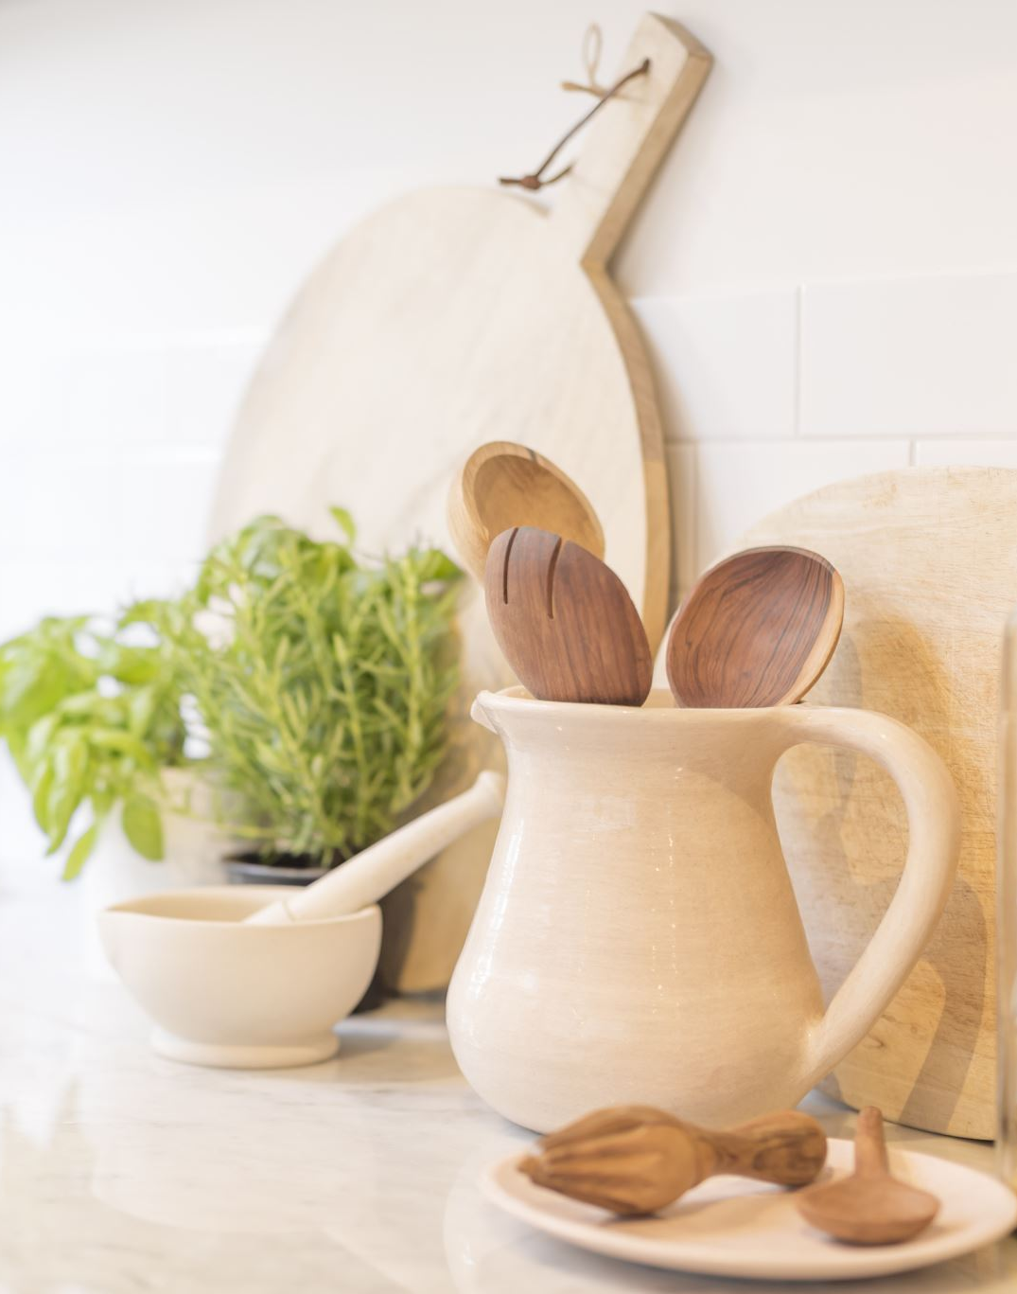
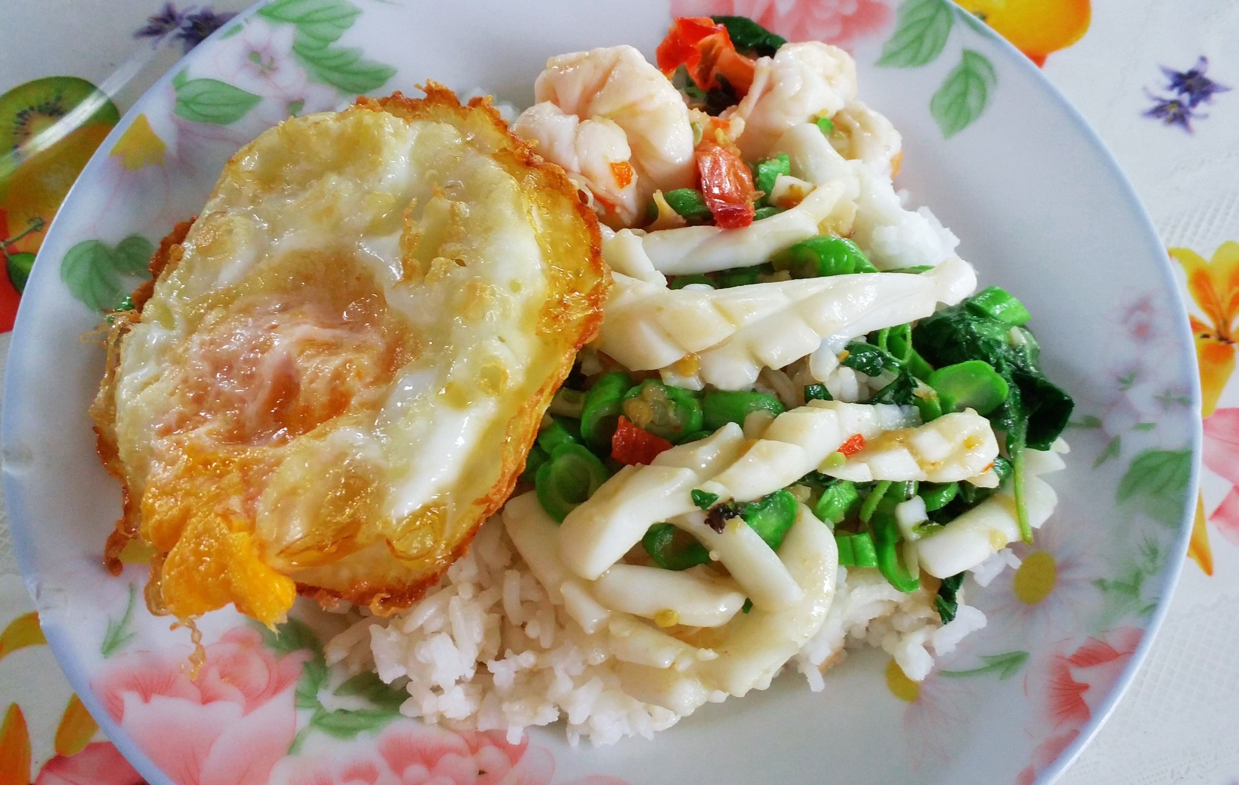
Dinners little helper by: Sami Crary and Nikolas Williams
Are you tired of having that conversation? Tired of the “what do you want for dinner?” Well then, have no fear, Dinners Little Helper is here!
This is a scrape tool designed to show what all is needed ingredients related, as well as the instructions on how to cook the dish.
Simply input what you would like to make when prompted to do so.
The output will help those wanting to cook, create real, good homestyle meals
https://github.com/ksu-is/Foodrecipe-scraper-1

